Slide 1
End to End Power BI Project

Slide 2
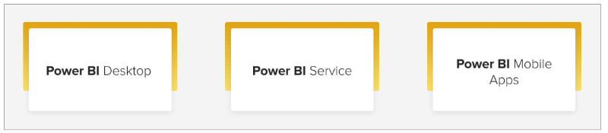
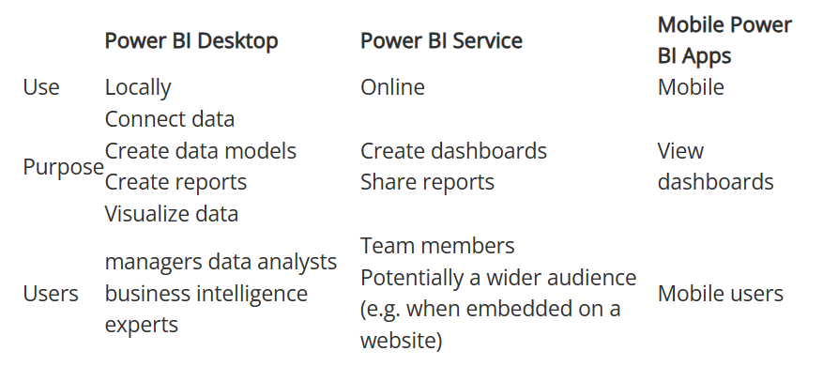
Basic Elements of Power BI

Slide 3
Work flow
Business Requirement Document (BRD)
Data Gathering
Data cleaning/Data Transformation
Data Modelling
DAX Functions
UI Report
RLS
Create Workspace and provide the workspace access
Publish the report
Dashboard/Mobile view
Gateway
Schedule the refresh
Subscribe , Manage Alerts
Share the report

Slide 4
Create a PBI report to answer these questions:
Top/Bottom 5 Product by sales
Sales by region
All details about the products ordered in a given order
Number of order by Date
Sales by Month
Number of order by month
Relationship between sales and quantity ordered

Slide 5
Row Level Security
RLS is the way to restrict the records to certain user
Static RLS : Is one of the method were you can use manage roles and simply we can say its like a filter similar to the dax function
Dynamic RLS: We will be using USER PRINCIPLE dax function ie., which will capture our usermail id at run time and based on that the access will be provided

Slide 6
Workspace
Workspace are the work area where all the organization's dashboards, reports, datasets, and other valuables are presented
My Workspace – Own purpose
New Workspace – Sharing the reports to the wider audience
Different type of Access: Viewer, Contributor/Member/Admin

Slide 7
Gateway
Gateway is used to connect the on premises data to PBI service
Manual refresh can be done in the PBI Desktop but to refresh the report automatically in service we need to schedule the refresh, for that we need this Gateway to be installed
There are 2 Gateways available : Standard Mode and Personal Mode
Schedule refresh for Pro users: 8 refreshes per day
and from premium per user: 48 refreshes per day

Slide 8
Dashboard
Dashboard is a single page view often it called as canvas
Once the report is published in service we pin the required visuals or KPI cards to dashboard
Dashboard is not interactive

Slide 9
Subscription
Subscription is to send a mail to the subscribed user with the dashboard according the scheduled time

Slide 10
Alerts
Whenever certain threshold limit is cross in Cards/KPI/Gauge chart we need to get a alert mail

